Slide 1
VehiVille-Online Car Rental
A Main Project seminar
on
Presented by
Abhishek Choudhary(1111) Sagar Kamble(1188) Gourav Panigrahi(1135)

Slide 2
Contents
➔ Introduction
➔ Existing System
➔ Proposed System
➔ Hardware Specifications
➔ Software Specifications
➔ System Flow Chart
➔ Modules
➔ Database
➔ Future Improvement
➔ conclusion

Slide 3
Introduction
➔VehiVille service is a rental service
➔Our Application offering cab rental and car hire making full use of information technology to improve level of efficiency
➔This project offers the best of services-both in terms of man and machine
➔It offers the online car rental service for corporate houses
➔It offers the best of rates and include the different categories of cars from luxery to budget

Slide 4
Existing System
An existing system can provide manually paper work.
The user has to go in the office where user can get the car on rent and book their car.
In the existing system you cannot provide feedback of the user to the admin online.
NEED FOR NEW SYSTEM
The new system is totally computerized system.
A new system provides features like time efficiency to show car details, user profiles and whatever the customer will give the feedback to the admin.
An inquiry is easily done by user in the system

Slide 5
Proposed system
The proposed system overcome the problems in the Existing system
Advantages of proposed system
➔ Data is centralized which has overcome the sharing problems in previous system
➔ As data is maintained electronically ,it’s easy for a person to update the details,which has overcome the tedious updations in previous system
➔ Maintenance is easy and performance is good
➔ Mainly the system is automated the transporation process

Slide 6
Software Specifications
➔Windows or any equivalent OS
Web Browser-Google Chrome or any compatible browser
➔Eclipse IDE
➔Server side Language- J2EE Spring Boot
➔Web Server-TOMCAT
➔Database Server-MYSQL

Slide 7
Hardware Specifications
➔ Dual Core Processor
➔ Client ->RAM 4 GB and Above
➔ Server ->RAM 6GB and bove
➔ HDD 20 GB HardDisk Space and Above

Slide 8
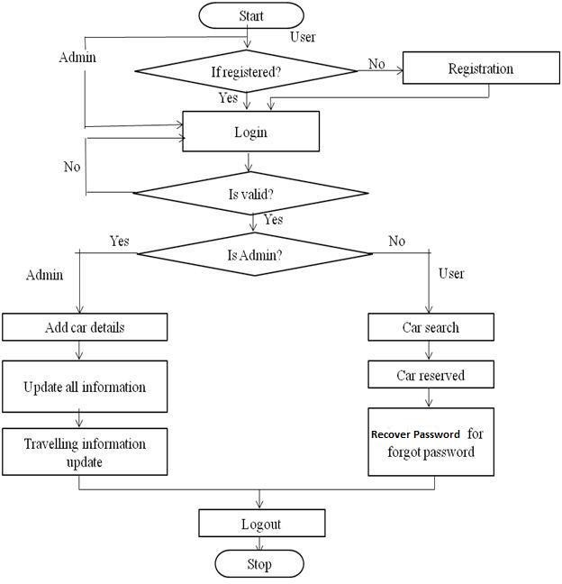
SYSTEM FLOW CHART

Slide 9
Modules
This project contain six modules
➔ Admin module
➔ User module

Slide 10
ADMIN MODULE
➔Admin is the Super user of the system.
➔Admin can add a car, manage booking car and rent and also view feedback and enquiry.
The Admin can add the car so that The user can see the available cars and book the car.
Admin can manage the bookings (confirm and cancel the booking),testimonials , contact us query.
admin can view the overview of the carrental (Like total vehicles, total booking, brands enquiry).
Admin can create/edit/delete vehicle brands

Slide 11
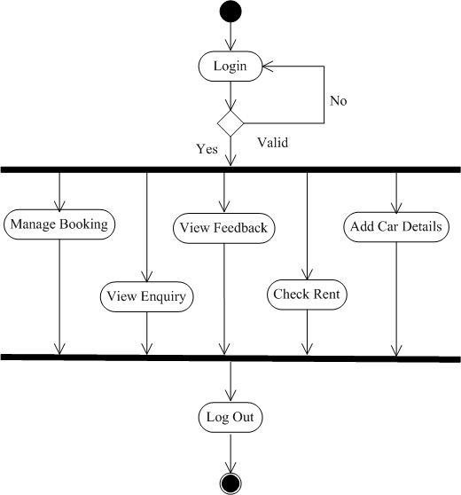
Activity Diagram for admin

Slide 12
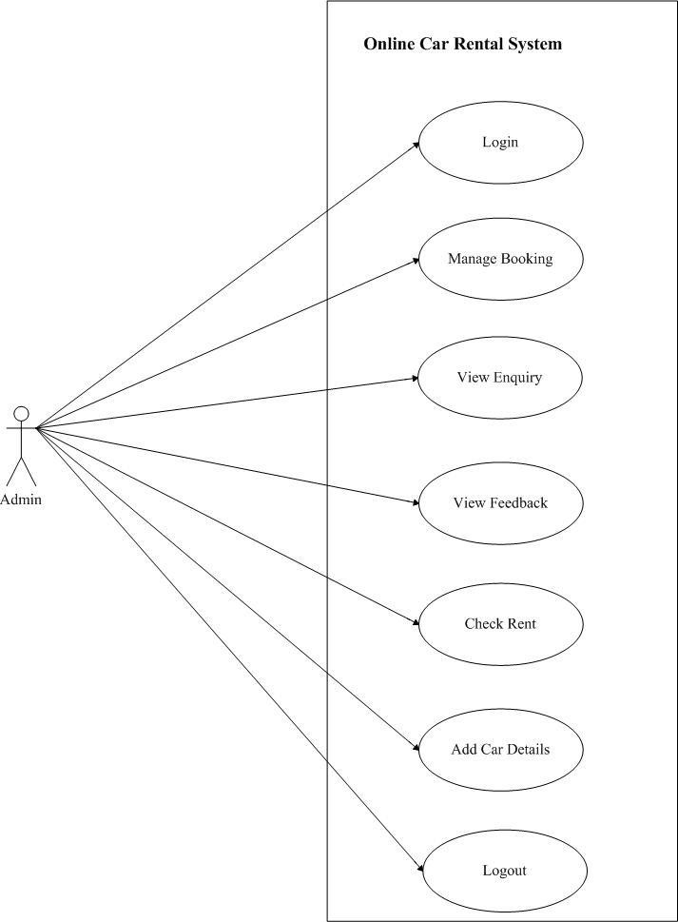
Admin Use Case

Slide 13
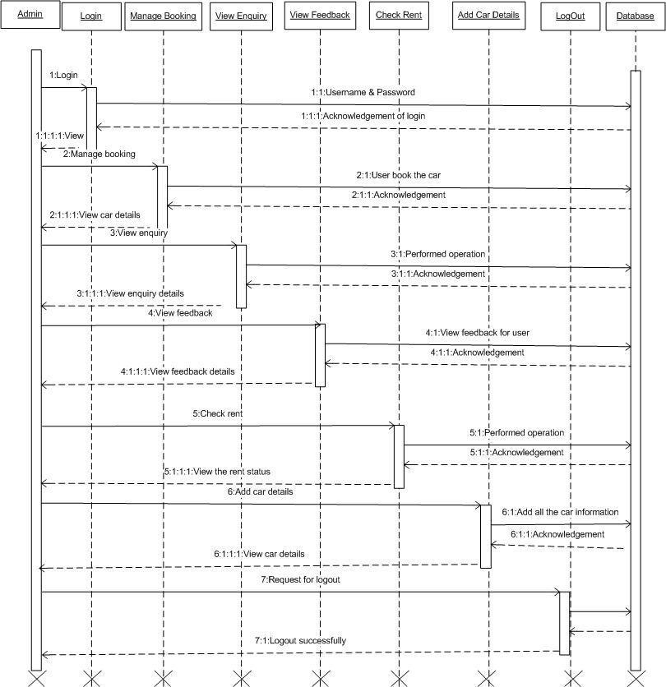
SEQUENCE DIAGRAM FOR ADMIN

Slide 14
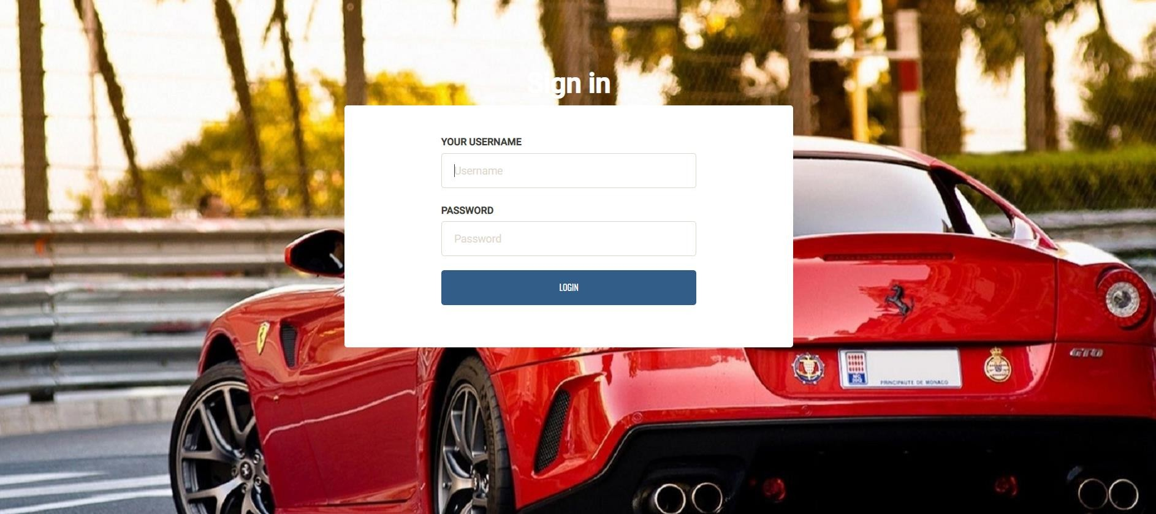
SIGN IN PAGE

Slide 15
USER MODULE
It is a system design especially for large, premium and small car rental business. The user can view Available cars and user can book for that car.
The user can view Available cars and user can book for that car.
The Customer can easily get the car whenever they need to on the rent with use of this system.
The user will give the feedback to the admin.
The inquiry can easily do by user.

Slide 16
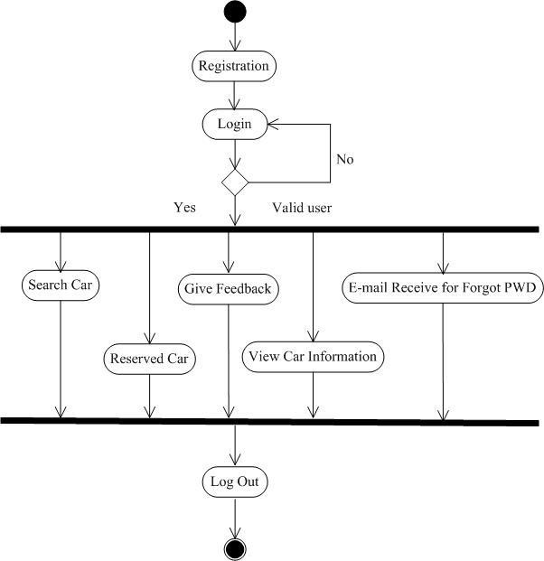
Activity Diagram for user

Slide 17
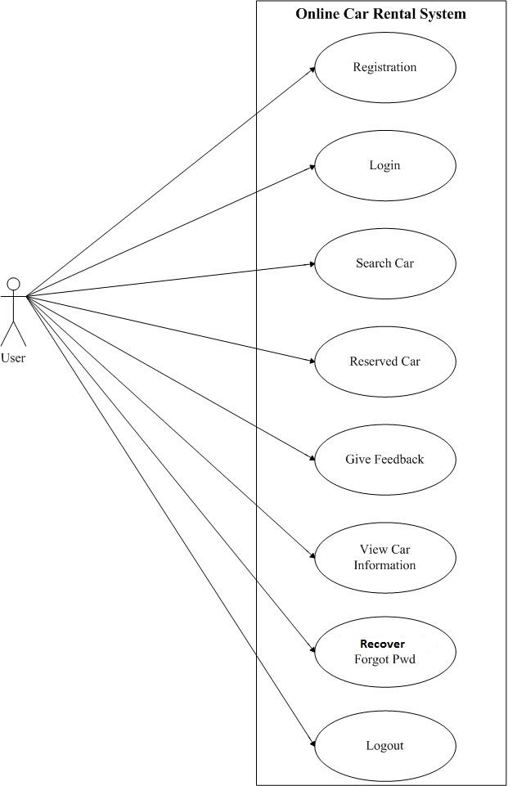
User Use Case

Slide 18
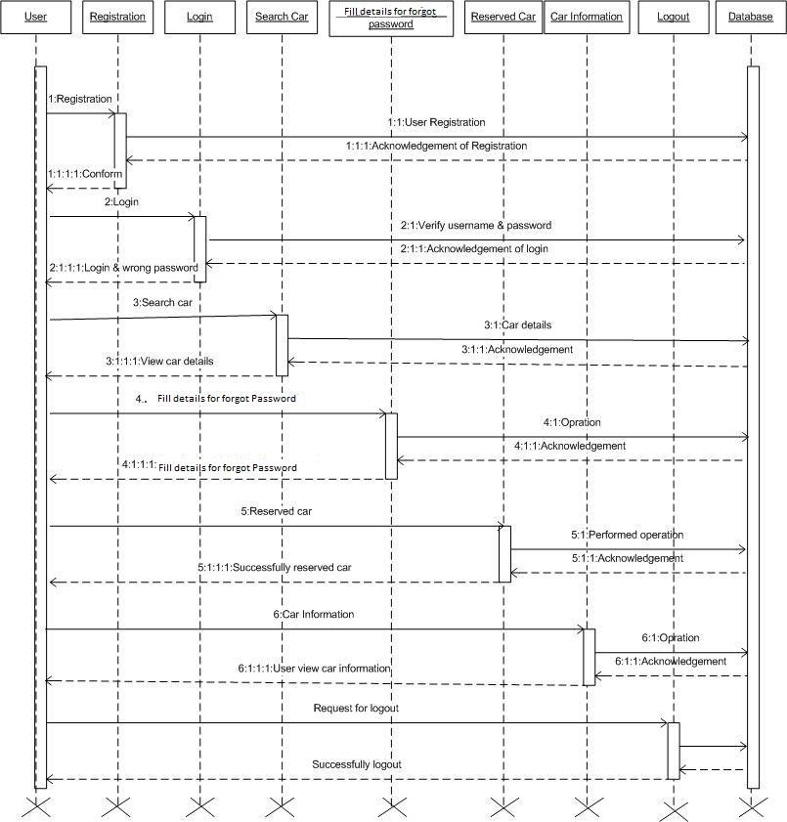
SEQUENCE DIAGRAM FOR USER

Slide 19
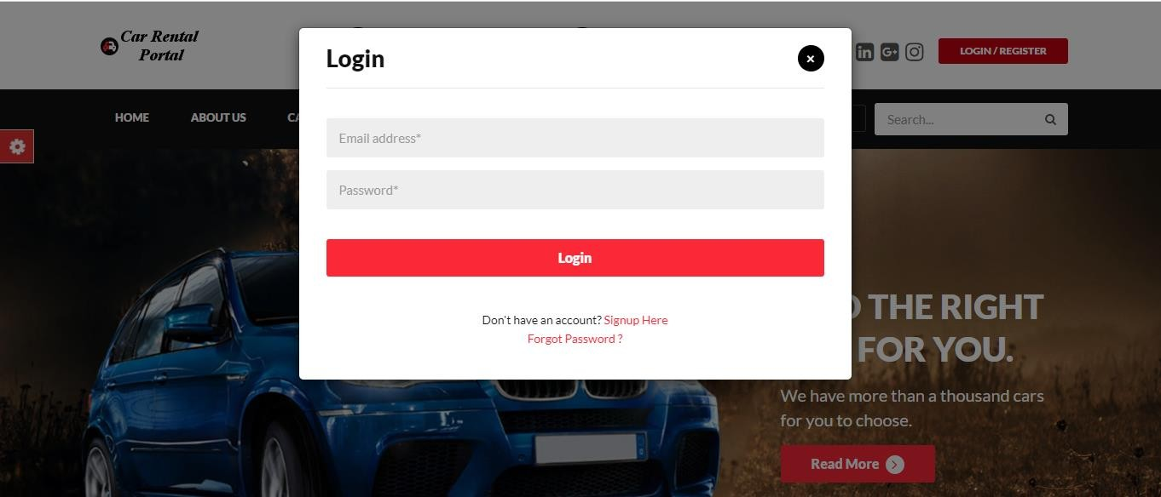
USER LOGIN

Slide 20
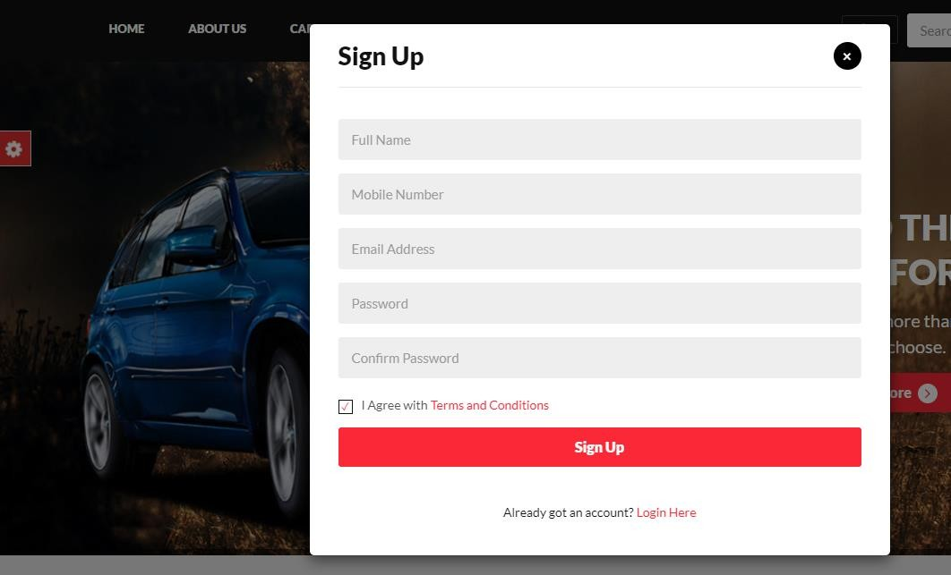
SIGN UP

Slide 21
Data Base
➔ MySql Server used for database
By using this we can create the tables with the details
➔ booking
➔ brand_name
➔ contact_us
➔ contact_us_query
➔ pages
➔ subscriber
➔ testimonial
➔ user
➔ user_role
➔ vehicle_details

Slide 22
Conclusion
➔ Car Rental Services is a Web application and it is restricted to only limited type of users.
➔ It is a system design especially for large, premium and small car rental business. The car rental system provides complete functionality of listing and booking car. In this system, Tourism and Travelling facilities also provide.
➔Here The Details of admin and users, cars are maintained.

Slide 23
Future Improvement
In future our application overcome the flaws if occurred and attain new features offered to users for the flexible and easy transportation
Following are the enhancements to the application
➔Add new car is representing the car list.
➔Add the current project for booking easy.
➔ Provide good user interface

